Slide 1
Year 2 – Spring Block 5 – Length and Height – Compare Lengths
About This Resource:
This PowerPoint has been designed to support your teaching of this small step. It includes a starter activity and an example of each question from the Varied Fluency and Reasoning and Problem Solving resources also provided in this pack. You can choose to work through all examples provided or a selection of them depending on the needs of your class.
National Curriculum Objectives:
Mathematics Year 2: (2M1) Compare and order lengths, mass, volume/capacity and record the results using >, < and =
Mathematics Year 2: (2M2) Choose and use appropriate standard units to estimate and measure length/height in any direction (m/cm); mass (kg/g); temperature (°C); capacity (litres/ml) to the nearest appropriate unit using rulers, scales, thermometers and measuring vessels
More Year 2 Length and Height resources.
Did you like this resource? Don’t forget to review it on our website.
© Classroom Secrets Limited 2019

Slide 2
Year 2 – Spring Block 5 – Length and Height
Step 3: Compare Lengths
© Classroom Secrets Limited 2019

Slide 3
Introduction
Sort the objects according to the unit you would use to measure them.
cm
m
© Classroom Secrets Limited 2019

Slide 4
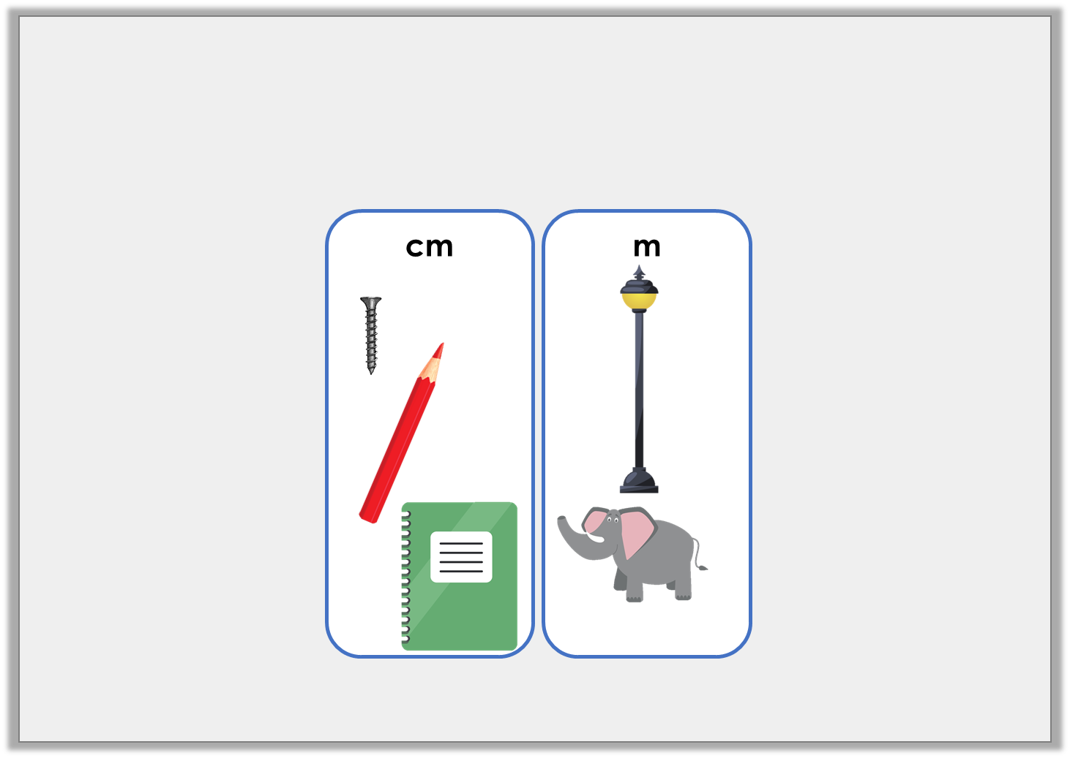
Introduction
Sort the objects according to the unit you would use to measure them.
© Classroom Secrets Limited 2019

Slide 5
Varied Fluency 1
Match the animals to their estimated lengths.
1m
4m
1cm
© Classroom Secrets Limited 2019

Slide 6
Varied Fluency 1
Match the animals to their estimated lengths.
1m
4m
1cm
© Classroom Secrets Limited 2019

Slide 7
Varied Fluency 2
Arrange the measurements from shortest to longest.
7 centimetres
20cm
9 centimetres
© Classroom Secrets Limited 2019

Slide 8
Varied Fluency 2
Arrange the measurements from shortest to longest.
7 centimetres
20cm
9 centimetres
7 centimetres
9 centimetres
20cm
© Classroom Secrets Limited 2019

Slide 9
Varied Fluency 3
Which statements are true?
A. | 84m | > | 64m
B. | 56cm | < | 56m
C. | 10m | = | 10cm
© Classroom Secrets Limited 2019

Slide 10
Varied Fluency 3
Which statements are true?
A. | 84m | > | 64m
B. | 56cm | < | 56m
C. | 10m | = | 10cm
© Classroom Secrets Limited 2019

Slide 11
Varied Fluency 4
Fill in the blanks to make the statements true.
36 centimetres |  | 36cm
96 centimetres |  | 63cm
49cm |  | 56cm
is shorter than
is the same as
is longer than
© Classroom Secrets Limited 2019

Slide 12
Varied Fluency 4
Fill in the blanks to make the statements true.
36 centimetres | is the same as | 36cm
96 centimetres | is longer than | 63cm
49cm | is shorter than | 56cm
© Classroom Secrets Limited 2019

Slide 13
Problem Solving 1
Susan’s ribbon is 59cm long and is shorter than Saffron’s.
Toby’s ribbon is the longest and measures 100cm.
Choose which measurement could describe Saffron’s ribbon.
48cm
73cm
1m
© Classroom Secrets Limited 2019

Slide 14
Problem Solving 1
Susan’s ribbon is 59cm long and is shorter than Saffron’s.
Toby’s ribbon is the longest and measures 100cm.
Choose which measurement could describe Saffron’s ribbon.
48cm
73cm
1m
© Classroom Secrets Limited 2019

Slide 15
Problem Solving 2
Arrange the cards below in the following template to create three true statements.
>
30m
<
68cm
68m
© Classroom Secrets Limited 2019

Slide 16
Problem Solving 2
Arrange the cards below in the following template to create three true statements.
Various answers, for example:
30m < 68m, 68cm < 68m, 68m > 30m
>
30m
<
68cm
68m
© Classroom Secrets Limited 2019

Slide 17
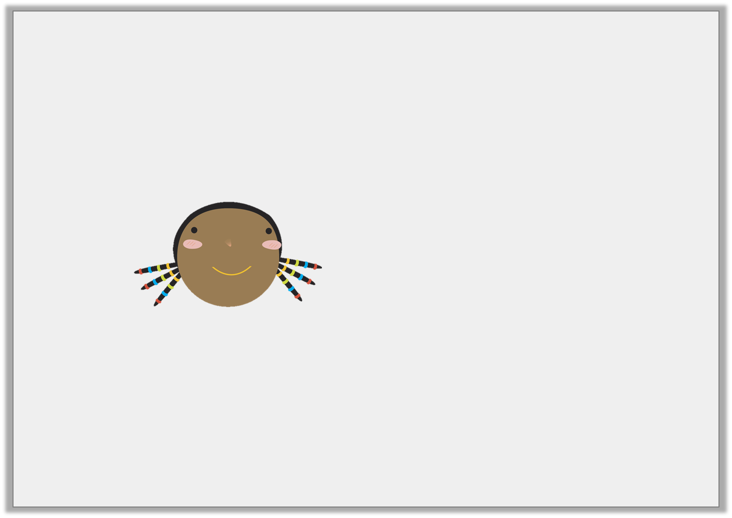
Reasoning 1
Sara uses a tape measure to find the length of three sand pits.
Pit A is 2m long, Pit B is 3m long and Pit C is 4m long.
Sara says,
Is she correct? Explain how you know.
Pit B is the smallest sand pit.
© Classroom Secrets Limited 2019

Slide 18
Reasoning 1
Sara uses a tape measure to find the length of three sand pits.
Pit A is 2m long, Pit B is 3m long and Pit C is 4m long.
Sara says,
Is she correct? Explain how you know.
Sara is not correct because…
Pit B is the smallest sand pit.
© Classroom Secrets Limited 2019

Slide 19
Reasoning 1
Sara uses a tape measure to find the length of three sand pits.
Pit A is 2m long, Pit B is 3m long and Pit C is 4m long.
Sara says,
Is she correct? Explain how you know.
Sara is not correct because 2m is smaller than 3m, so Pit A is the smallest sand pit.
Pit B is the smallest sand pit.
© Classroom Secrets Limited 2019

