Slide 1
LIFE/work balance
We have started a #LIFEworkbalance campaign and we need your help to complete our LIFE/work balance survey.
We hope to publish the results soon, so please give 15 minutes of your time to help us get a true picture of school life.
Want to be a part of this campaign? Take the survey on our website and share it with your colleagues!
© Classroom Secrets Limited 2020

Slide 2
Year 2 – Spring Block 3 – Properties of Shape – Count Edges on 3D Shapes
About This Resource:
This PowerPoint has been designed to support your teaching of this small step. It includes a starter activity and an example of each question from the Varied Fluency and Reasoning and Problem Solving resources also provided in this pack. You can choose to work through all examples provided or a selection of them depending on the needs of your class.
National Curriculum Objectives:
Mathematics Year 2: (2G2b) Identify and describe the properties of 3-D shapes, including the number of edges, vertices and faces
More Year 2 Properties of Shape resources.
Did you like this resource? Don’t forget to review it on our website.
© Classroom Secrets Limited 2018

Slide 3
Year 2 – Spring Block 3 – Properties of Shape
Step 9: Count Edges on 3D Shapes
© Classroom Secrets Limited 2018

Slide 4
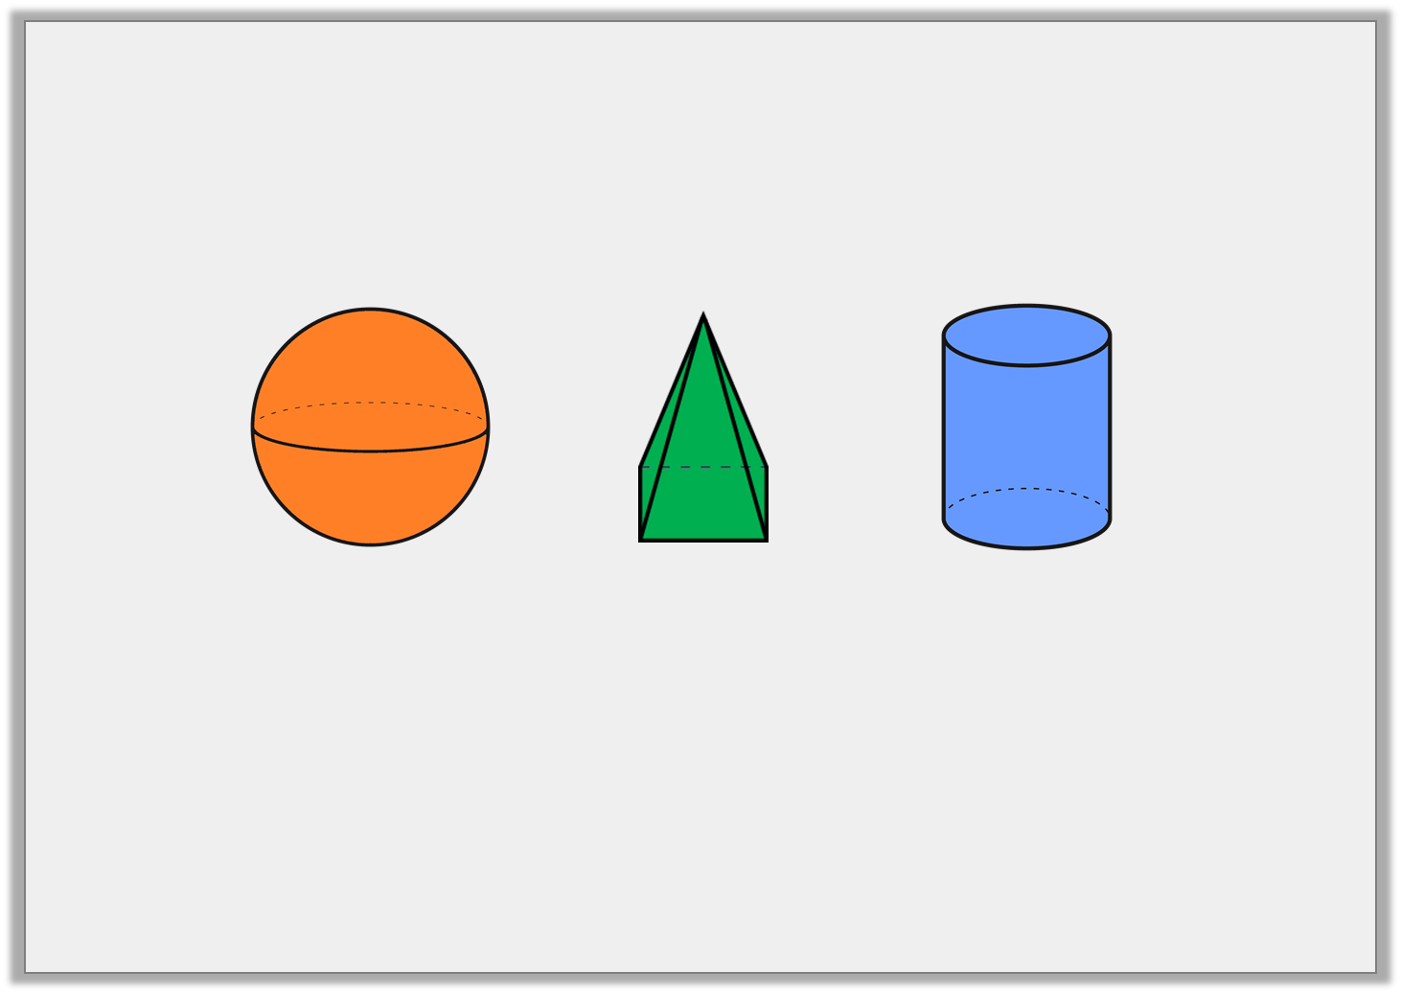
Introduction
Count the edges on each shape.
© Classroom Secrets Limited 2018

Slide 5
Introduction
Count the edges on each shape.
0 edges
8 edges
2 edges
© Classroom Secrets Limited 2018

Slide 6
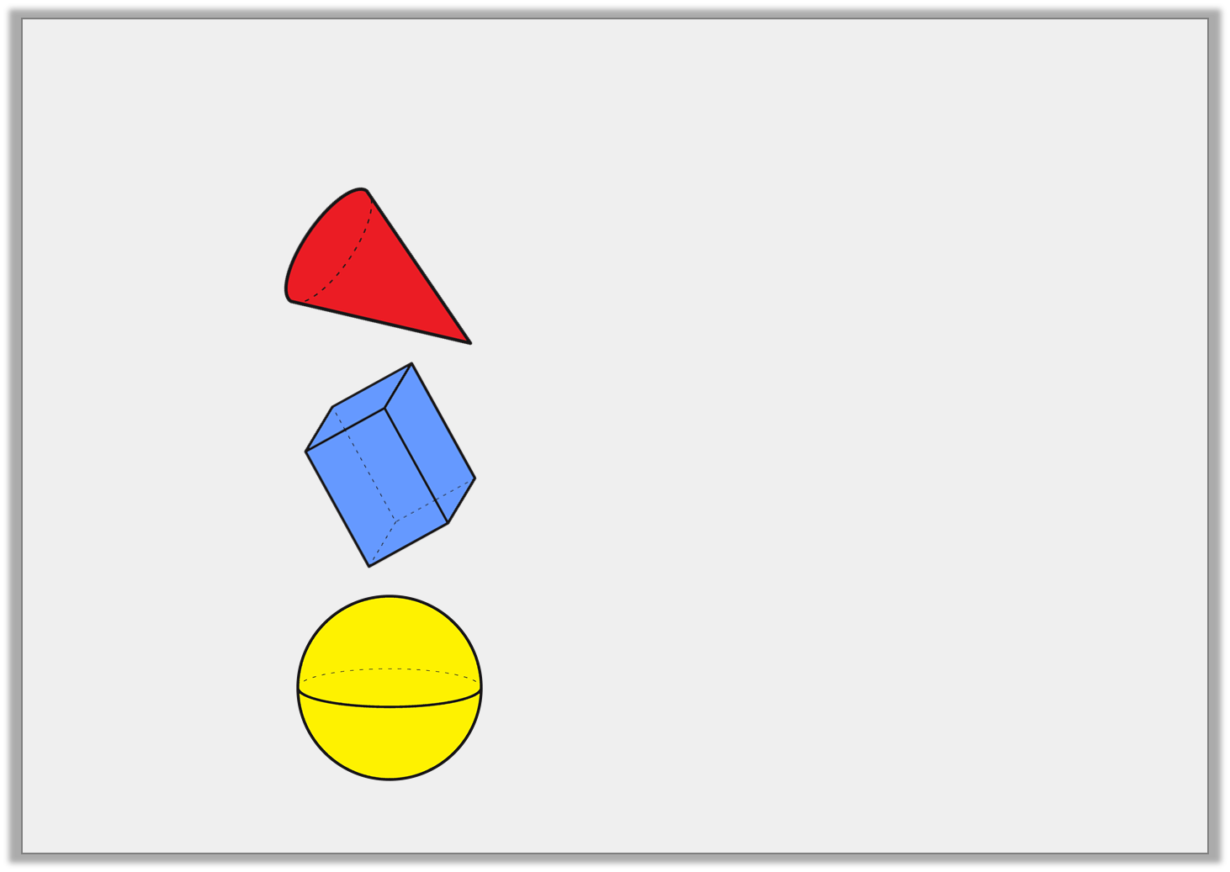
Varied Fluency 1
Match the 3D shapes to the correct number of edges.
A.
0 edges
6 edges
B.
1 edge
12 edges
C.
© Classroom Secrets Limited 2018

Slide 7
Varied Fluency 1
Match the 3D shapes to the correct number of edges.
A.
0 edges
6 edges
B.
1 edge
12 edges
C.
© Classroom Secrets Limited 2018

Slide 8
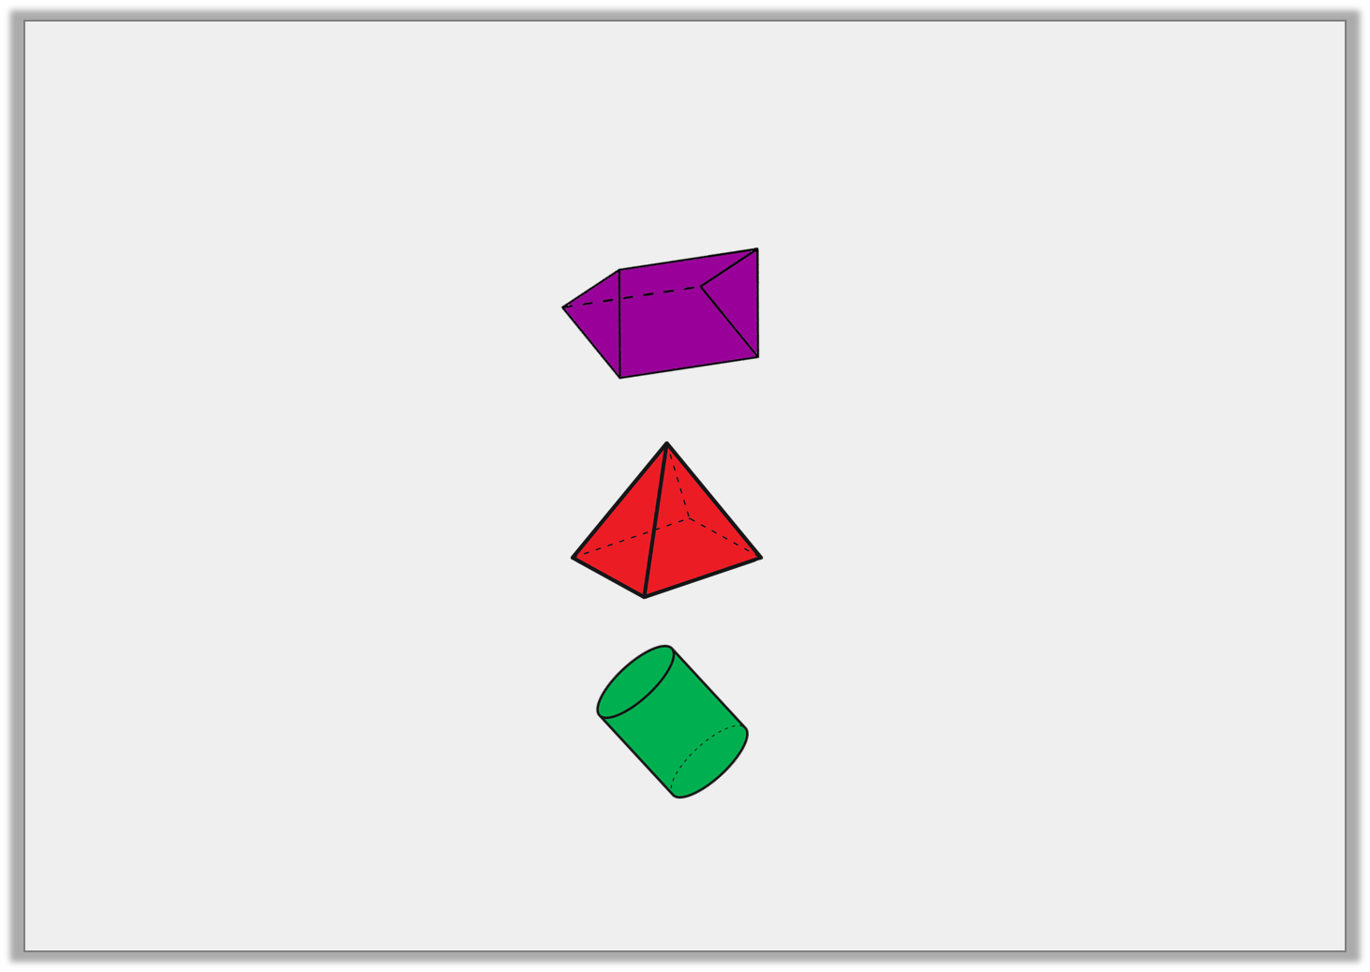
Varied Fluency 2
Tick the shape below that has 2 edges.
A.
B.
C.
© Classroom Secrets Limited 2018

Slide 9
Varied Fluency 2
Tick the shape below that has 2 edges.
A.
B.
C. |  | 
© Classroom Secrets Limited 2018

Slide 10
Varied Fluency 3
Lucas is describing one of the 3D shapes below.
He says,
What shape is Lucas describing?
My shape has 12 edges.
© Classroom Secrets Limited 2018

Slide 11
Varied Fluency 3
Lucas is describing one of the 3D shapes below.
He says,
What shape is Lucas describing?
cuboid
My shape has 12 edges.
© Classroom Secrets Limited 2018

Slide 12
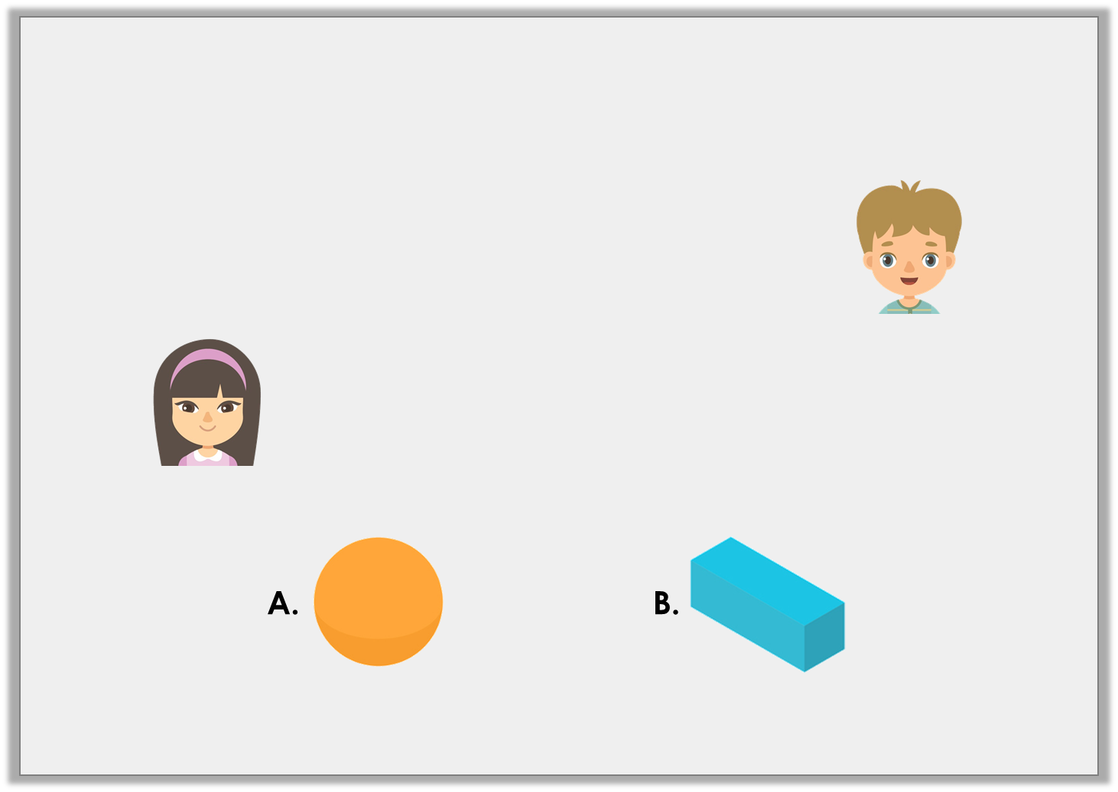
Problem Solving 1
Match each child to the shape they are describing.
My shape has 0 edges.
Thomas
My shape has 12 edges.
Molly
© Classroom Secrets Limited 2018

Slide 13
Problem Solving 1
Match each child to the shape they are describing.
Thomas = A; Molly = B
My shape has 0 edges.
Thomas
My shape has 12 edges.
Molly
© Classroom Secrets Limited 2018

Slide 14
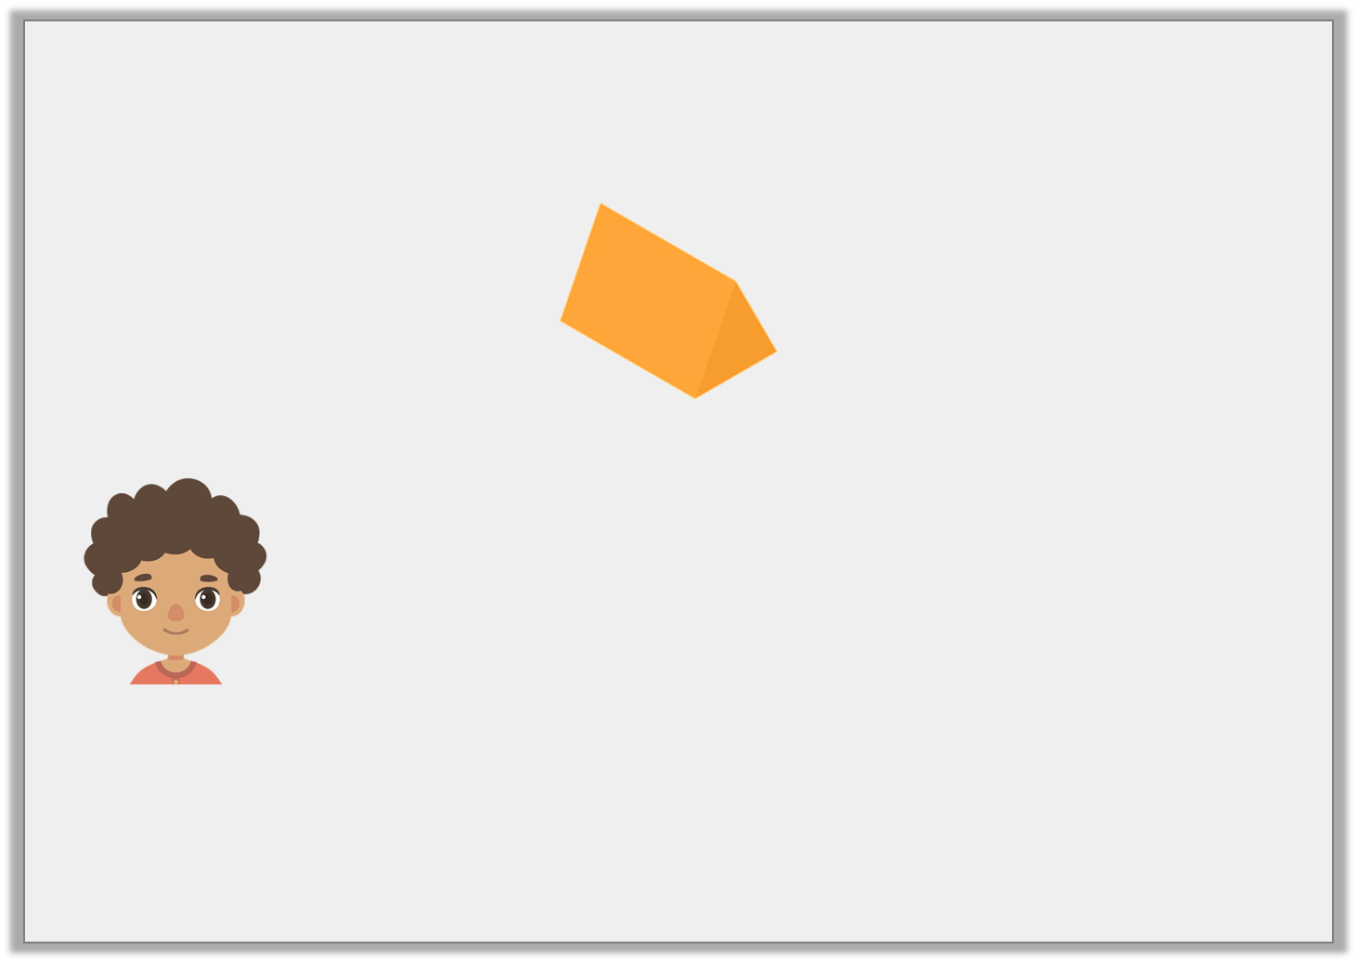
Reasoning 1
Caleb is describing the shape below.
He says,
Do you agree? Explain your answer.
The triangular prism has 6 edges.
© Classroom Secrets Limited 2018

Slide 15
Reasoning 1
Caleb is describing the shape below.
He says,
Do you agree? Explain your answer.
Caleb is incorrect because…
The triangular prism has 6 edges.
© Classroom Secrets Limited 2018

Slide 16
Reasoning 1
Caleb is describing the shape below.
He says,
Do you agree? Explain your answer.
Caleb is incorrect because the triangular prism has 9 edges.
The triangular prism has 6 edges.
© Classroom Secrets Limited 2018

Slide 17
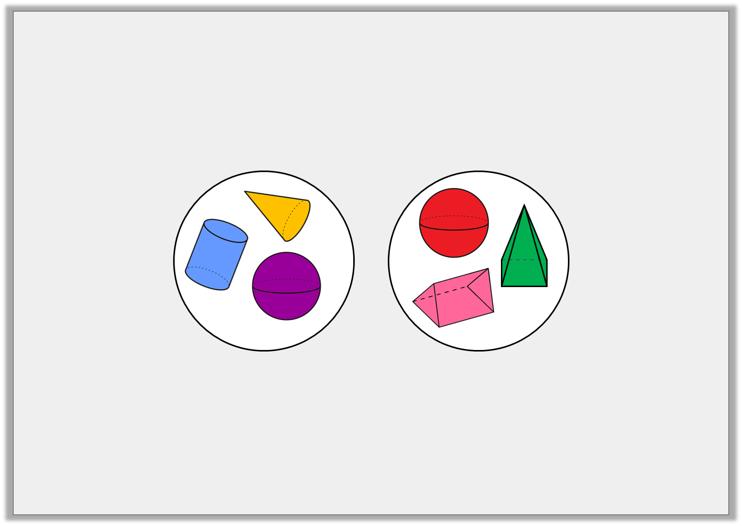
Reasoning 2
Ted has made a mistake when sorting 3D shapes.
What has he done wrong?
Fewer than
3 edges
More than
3 edges
© Classroom Secrets Limited 2018

Slide 18
Reasoning 2
Ted has made a mistake when sorting 3D shapes.
What has he done wrong?
Ted has but the sphere in the wrong group because…
Fewer than
3 edges
More than
3 edges
© Classroom Secrets Limited 2018

Slide 19
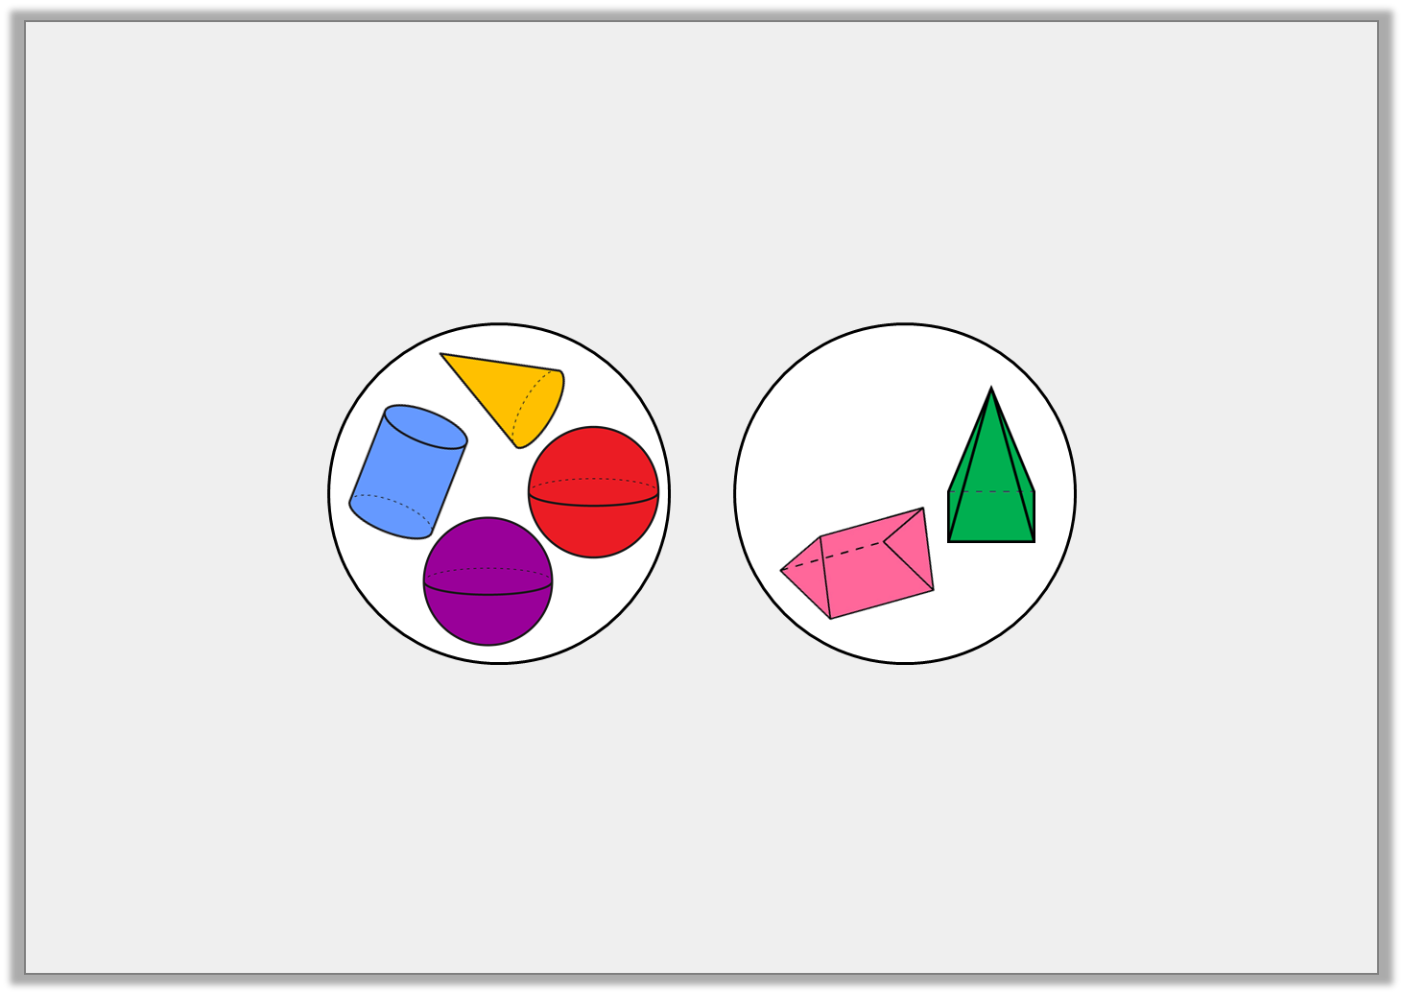
Reasoning 2
Ted has made a mistake when sorting 3D shapes.
What has he done wrong?
Ted has but the sphere in the wrong group because a sphere has 0 edges which is fewer than 3. Both spheres should be in the same group.
Fewer than
3 edges
More than
3 edges
© Classroom Secrets Limited 2018

