Slide 1
Superhero Villains

Slide 2
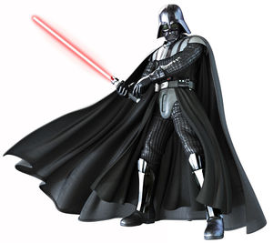
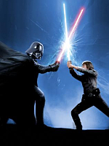
Luke Skywalker’s enemy and his father
Evil and powerful
Strong command over the Dark Side
Excellent with a lightsaber
Very good at killing his enemies
Darth Vader

Slide 3
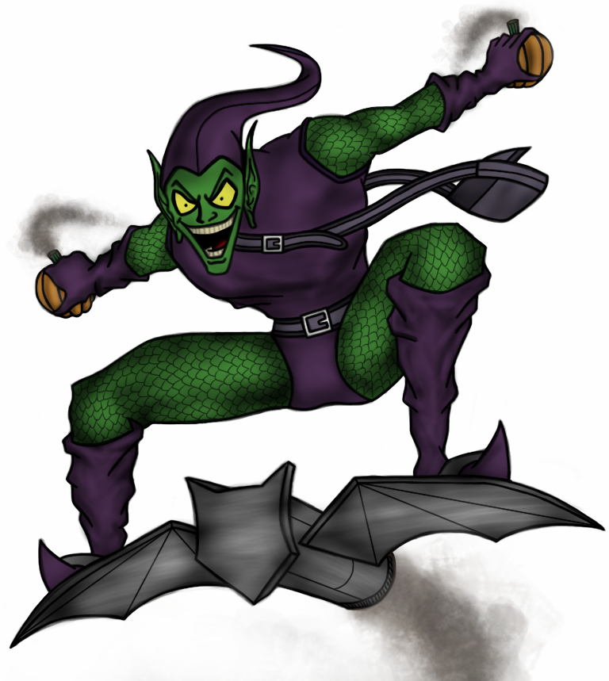
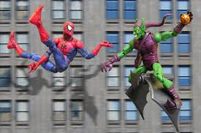
Spiderman’s enemy
Superhuman strength
Weapons include: pumpkin bombs, gas
bats and a glider
Very agile, nimble and crafty
Green Goblin

Slide 4
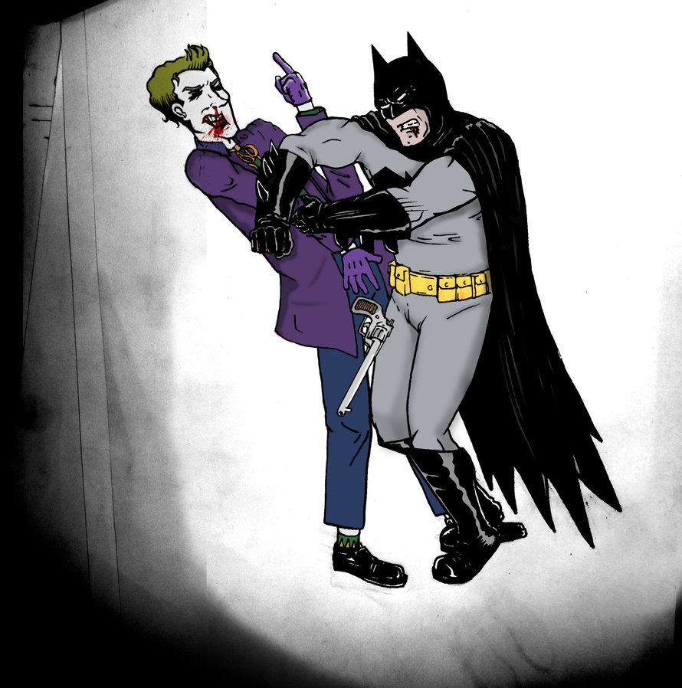
Batman’s enemy
Criminal mastermind
Evil clown
Aims to cause as much misery and
destruction as possible in Gotham
Not to be trusted
The Joker

Slide 5
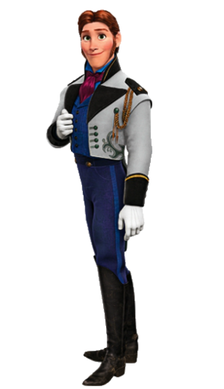
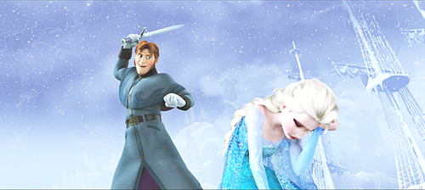
Prince Hans Westerguard
Dishonest, selfish and deceitful
Left Anna to die
Wants to kill Queen Elsa
Excellent swordsmanship

Slide 6
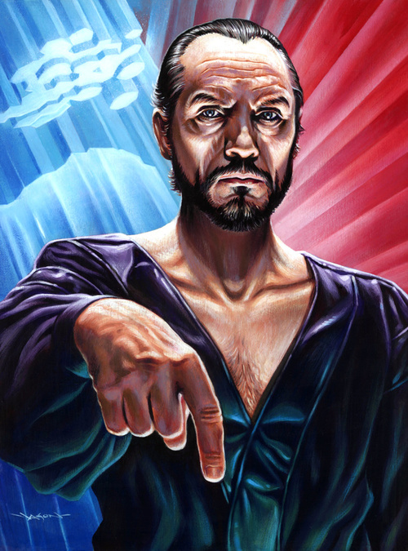
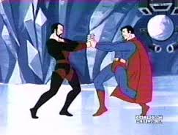
Superman’s enemy
Zod is a warlord from Superman's home planet of Krypton
Has two evil sidekicks: Non and Ursa
As powerful as Superman!
Wants to take over the world
General Zod

Slide 7
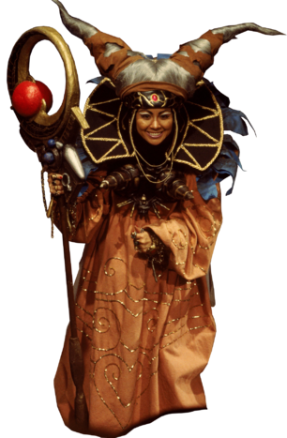
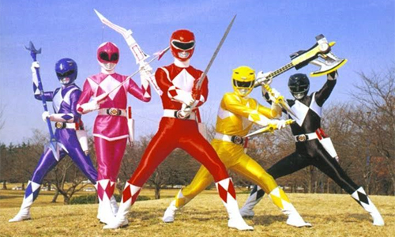
Evil humanoid alien witch
First villain that the Power Rangers had to face
Magical powers and sorcery
Can trap people in other dimensions
Can teleport herself and others
Wants to invade Earth
Rita Repulsa

Slide 8
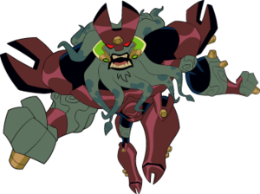
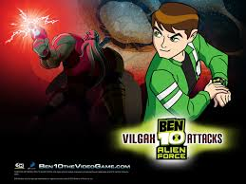
Galactic Conqueror
Ben 10’s enemy
Superhuman strength
Lots of weapons
Likes conquering planets
Wants to obtain the Omnitrix, rule the Universe and kill Ben 10!
Vigilax

Slide 9
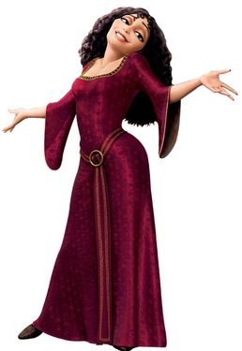
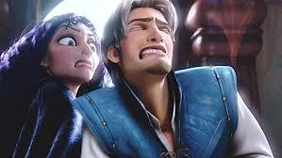
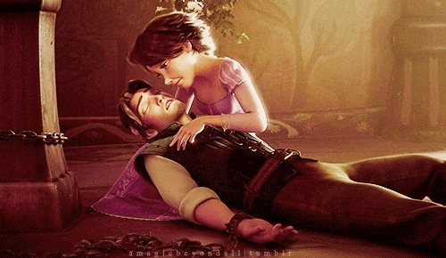
Imprisoned Rapunzel in a tower
Selfish, cunning and uncaring
Wants to remain young and beautiful
forever – at whatever cost
Has a dagger
Tries to kill Eugene/Flynn
Mother Gothel

Slide 10
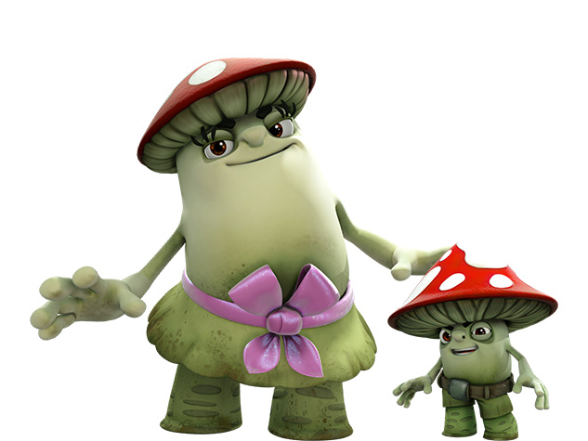
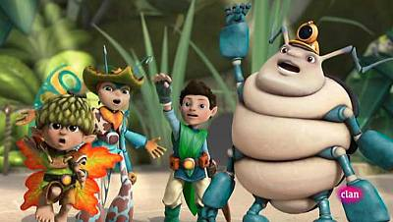
Cause trouble for Tree Fu Tom
Naughty
Only think about themselves
The Mushas: Puffy and Stink

Slide 11
Who’s your favourite villain?

